Slide 1
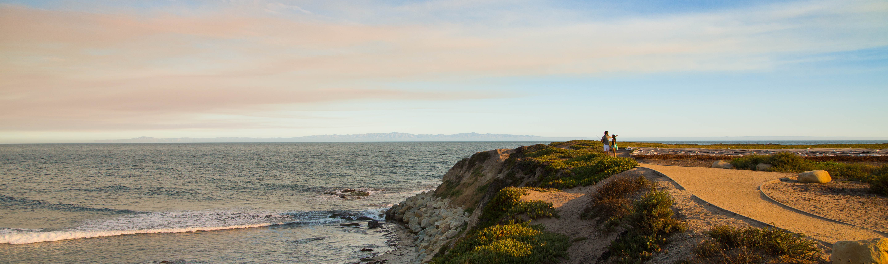



Reproducing and Replicating Spatial Data Science
Joseph Holler, Peter Kedron, and Sarah Bardin
HEGSRR.github.io
Funding Support from NSF BCS-2049837, NSF OAC-1743184

Slide 2
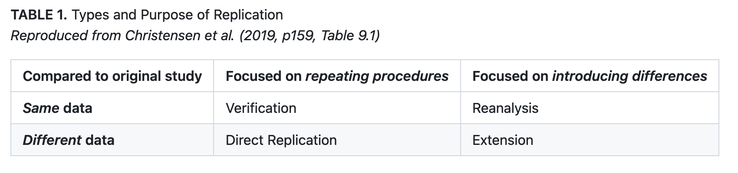
Reproduction and Replication
(Schmidt 2009, Gomez et al. 2010, Barba 2017, Christensen et al. 2019, NASEM 2019)

Slide 3
Reproduction and Replication
(Schmidt 2009, Gomez et al. 2010, Barba 2017, Christensen et al. 2019, NASEM 2019)
Reproduction
Same data, same procedure, same results, same context

Slide 4
Reproduction and Replication
(Schmidt 2009, Gomez et al. 2010, Barba 2017, Christensen et al. 2019, NASEM 2019)
Reproduction
Same data, same procedure, same results, same context
Replication
New data, similar procedure, similar results, same or new context

Slide 5
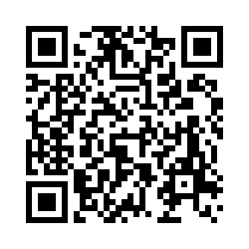
Tell us what you think
Please take 2mins to complete a short survey about open science research practices
go.middlebury.edu/hegsrr
Protocol
11 open and reproducible research practices (ORRP)
10 ORRP technology adoption questions
Email post-workshop follow up
Email one-year follow-up
Share aggregate results here
Share anonymized results on website

Slide 6
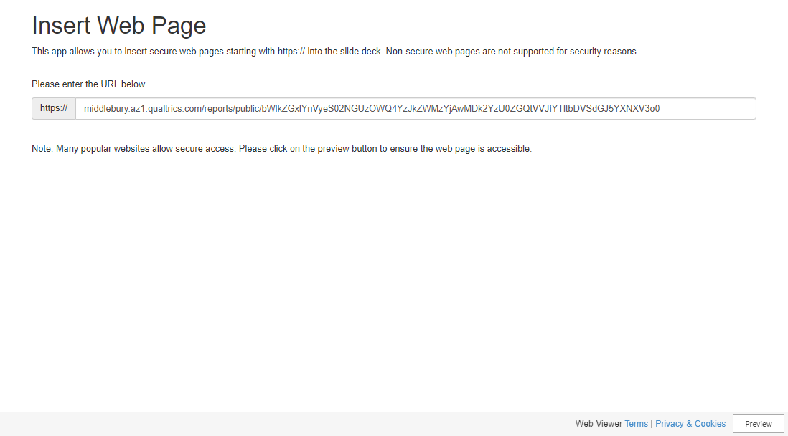
Link to Report

Slide 7
Open Science Practices
Selected open science and reproducibility supporting research practices
Share Data
Do you share data in a permanent location with a persistent identifier?
Share Methods and Code
Do you share a complete description of your methods?
Metadata
Do you provide information about the provenance of the components of your work?
Version control
Do you track and manage changes to your code?
Reproducible Computational Environment
Do you provide sufficient information about your work environment that others can recreate it?

Slide 8
Open Science Practices
Selected open science and reproducibility supporting research practices
Research Compendium
Do you collect all the digital components of your work together?
Digital Archive with DOI
Are all the components of your work stored and labelled with a permanent ID?
Pre-registration
Do you publicly register your hypotheses and research design before conducting your work?
Open Source Software
Do you use software that distributes its source code? Do you share yours?
Open Licensing
Do you openly license your work products to allow other to use/build on them?
Reproduction or Replication Studies
Do you attempt and share reproduction or replication studies?

Slide 9
Veridical Spatial Data Science
Munafo et al. (2016), Kedron et al. (2020), Yu & Kumbier (2020)
Principled inquiry to extract reliable and reproducible information from spatialtemporal data, with an enriched technical language to communicate and evaluate empirical evidence in the context of human decisions, domain knowledge, and geographic confounds; supported by a system of external validation and evidence accumulation based on the purposeful replication of findings across space and time.
(Adapted from Kedron and Bardin 2021, Yu and Kumbier 2020)

Slide 10
Veridical Spatial Data Science
Munafo et al. (2016), Kedron et al. (2020), Yu & Kumbier (2020)
Question
Communicate
Research Design
g
a
b
Data
Collection
Interpret
f
abcdefg = n
e
c
Data
Management
d
Modeling
& Analysis
Data
Exploration

Slide 11
Conclusions
Example Studies – Reproducibility – Internal Validity Spatiotemporal Metascience – Collaboration
Follow our work at
HEGSRR.github.io
(with links to OSF and GitHub)
opengisci.github.io
(GIScience course at Middlebury)
Notes:
To conclude, we have a growing set of example R&R studies for use in teaching or future metascience,
Each of the studies is now more reproducible than the original,
We have checked their internal validity by attending to and reanalyzing researcher decisions and deviations,
We hope wide adoption of our template or something similar would enable spatiotemporally explicit metascience – series of replications or metaanalyses
And finally, we invite feedback and collaboration, and hope that the many individual efforts to advance open spatiotemporal data science are reaching a critical mass ready for collaboration and scaling.

